Slide 1

Algorithms & Data Structures
Week 6
Graphs

Slide 2
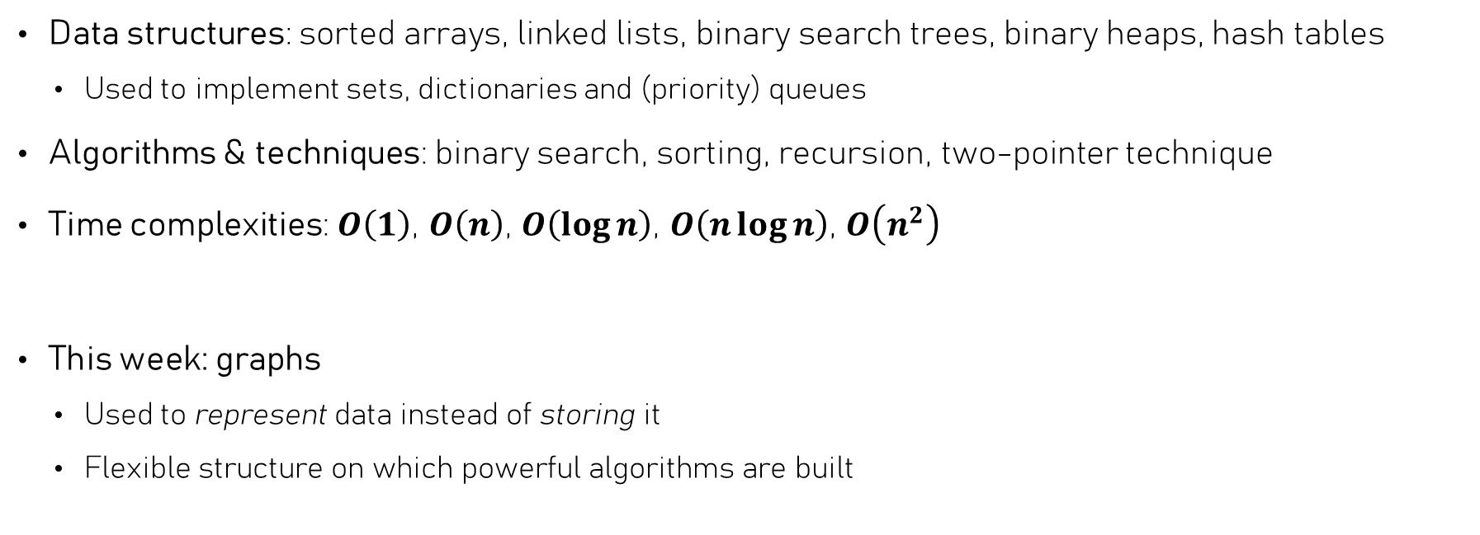
Last weeks we discussed…
Data structures: sorted arrays, linked lists, binary search trees, binary heaps, hash tables
  Used to implement sets, dictionaries and (priority) queues
Algorithms & techniques: binary search, sorting, recursion, two-pointer technique
Time complexities: $O\left(1\right)$, $O\left(n\right)$, $O\left(\log{n}\right)$, $O\left(n\log{n}\right)$, $O\left(n^{2}\right)$
This week: graphs
  Used to represent data instead of storing it
  Flexible structure on which powerful algorithms are built

Slide 3
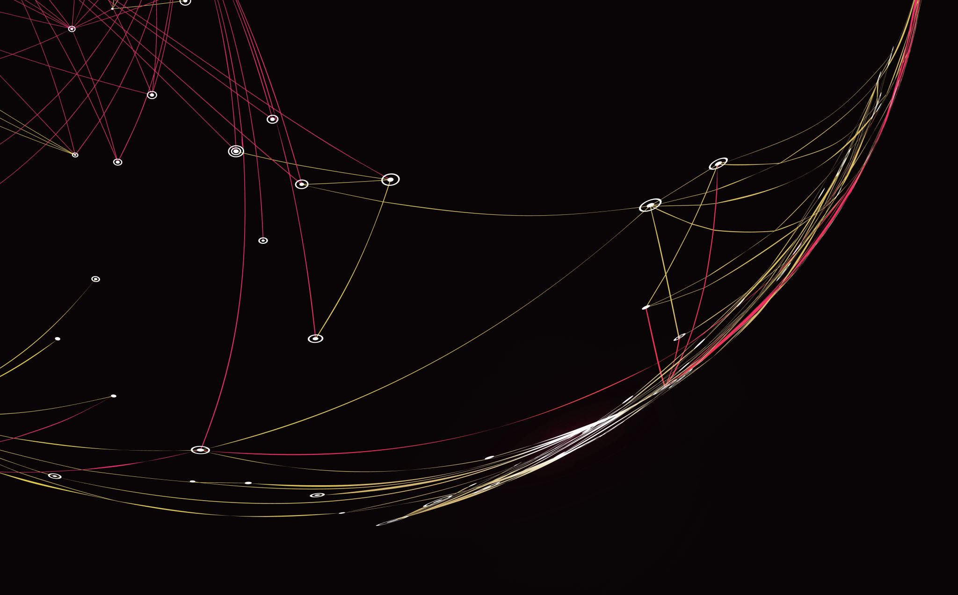
Graphs
Linking data together, without restrictions

Slide 4




Graphs in real life
People connected by friendships
Bob
Charlie
Alice
Social networks
The internet / world-wide web
Maps
Eve
Jill
Pages connected by links
200
search.com
20
Enschede
Leiden
80
140
240
news.de
Den Haag
70
Utrecht
180
xyz.com
abc.nl
Cities connected by roads
Maastricht

Slide 5
Graphs – terminology
A weighted, undirected
graph
200
20
Enschede
Leiden
80
140
240
A graph consists of Nodes (or vertices) & Edges
  Each edge connects two nodes
  Nodes can have any number of connections.
  Edges can be directed or undirected
  Edges can have weights
  A path is a sequence of connected edges
Graphs can be cyclic
  A path of at least two edges connects
  a node with itself
Den Haag
70
Utrecht
180
Maastricht
Cyclic!
B
D
An
undirected
graph
A
C
E
B
D
F
A directed
graph
A
C
E
Directed acyclic graph (DAG)

Slide 6
Graphs – terminology
Connected!
B
D
A
An undirected graph is connected if
  Any two nodes are connected by a path
A directed graph is strongly connected if
  Any two nodes are connected by a path
And weakly connected if, ignoring edge directions, it would be connected
C
E
Disconnected!
B
D
E
A
C
F
B
D
F
Two connected
components
A
C
E
Weakly connected

Slide 7
Graph – Representations
B
D
F
A
C
E
Two main ways to represent graphs
Adjacency matrix: two-dimensional “array” with edges
Adjacency list: maintain a list of edges per node
A
B
C
D
E
F
A
 | 1 | 1
 |  | 1 | 1
 |  |  |  | 1
 |  | 1 |  | 1 | 1
 |  |  |  | 1
B
A
{B, C}
D
{C, E, F}
C
From
B
{C, D}
E
{}
D
C
{E}
F
{E}
E
F

Slide 8
Graph – Representations
1
3
B
D
0
A
If nodes have an “id” / “index”
C
Adjacency lists in C++: many possibilities
  std::vector< std::vector<int> >
  std::vector< std::forward_list<int> >
  std::unordered_map< Node, std::vector<Node> >
  std::unordered_map< Node, std::unorderd_map<Node, Edge> >
E
2
4
A
{B, C}
D
{B, C, E}
B
{A, C, D}
E
{C, D}
C
{A, B, D, E}
Primary operation: lookup a node’s neighbours
Why not use std::map?
Only relevant if Edge contains useful information

Slide 9
Graph algorithms
Finding a suitable representation of a graph is just one thing
Performance matters, but of main importance are the algorithms we run on graphs
Basic algorithms:
  Pathfinding: finding all reachable nodes & their “distances”
  Ordering nodes in directed graphs
  Finding cycles
B
D
F
A
E
C
G

Slide 10
Pathfinding & Graph traversal
Depth
first
To find all nodes reachable from a certain node:
  Iterate edges to find neighbouring nodes – these are reachable
  Find all nodes reachable from those neigbours (recursion?!)
Two main ways to traverse / search a graph in this way:
  Depth first search: try to go as far as possible, then backtrack
  Breadth first search: visit all neighbouring nodes before visiting their neighbours
1
2
3
4
2
3
1
4
Breadth
first
5

Slide 11
Traversing a Graph – DFS
B
D
Depth-first traversal – recursively
  Start from A
A
F
C
E
dfs(F)
function dfs(start):
colour_node(start, 'blue')
for neighbor in neighbors(start):
dfs(neighbor)
colour_node(start, 'red')
dfs(E)
dfs(D)
dfs(F)
dfs(E)
dfs(D)
dfs(C)
dfs(B)
dfs(A)
Call stack

Slide 12
Traversing a Graph – DFS
Where does this end?
B
D
Depth-first traversal – recursively
  Start from A
A
F
dfs(F)
C
E
function dfs(start):
colour_node(start, 'blue')
for neighbor in neighbors(start):
dfs(neighbor)
colour_node(start, 'red')
dfs(E)
dfs(D)
dfs(F)
We must keep track of what we’ve already visited!
dfs(E)
dfs(D)
dfs(C)
dfs(B)
dfs(A)
Call stack

Slide 13
Traversing a Graph – DFS
B
D
Depth-first traversal – keeping track of visited nodes
  Start from A
A
F
visited is passed by reference
C
E
function dfs(start, visited):
visited.insert(start)
colour_node(start, 'blue')
for neighbor in neighbors(start):
if neighbor not in visited:
dfs(neighbor, visited)
colour_node(start, 'red')
dfs(F, visited)
dfs(C, visited)
dfs(E, visited)
dfs(D, visited)
What kind of data structure is visited?
dfs(B, visited)
dfs(A, visited)
Call stack
visited:
A
B
D
E
F

Slide 14
Traversing a Graph – DFS
B
D
Depth-first traversal – keeping track of visited nodes
  Start from A
A
F
visited is passed by reference
C
E
function dfs(start, visited):
visited.insert(start)
colour_node(start, 'blue')
for neighbor in neighbors(start):
if neighbor not in visited:
dfs(neighbor, visited)
colour_node(start, 'red')
dfs(C, visited)
dfs(E, visited)
dfs(D, visited)
dfs(B, visited)
dfs(A, visited)
Call stack
visited:
A
B
D
E
F
C

Slide 15
Traversing a Graph – DFS
Let’s search from A
B
D
Now let’s use iteration instead of recursion
Make use of a stack
  Top of stack = current node, visit it
  Push unvisited neighbours
Same node may be pushed multiple times
  Should check if it was already visited
A
F
C
E
= Visited
A
B
C
B
D
E
Stack

Slide 16
Traversing a Graph – DFS
B
D
function dfs(start):
s ← empty stack
visited ← empty set
s.push(start)
while s not empty:
v = s.pop()
if v not in visited:
visited.insert(v)
for w in neighbors of v:
if w not in visited:
s.push(w)
A
F
C
E
= Visited
B
B
D
E
D
F
Stack

Slide 17
Traversing a Graph – DFS
B
D
function dfs(start):
s ← empty stack
visited ← empty set
s.push(start)
while s not empty:
v = s.pop()
if v not in visited:
visited.insert(v)
for w in neighbors of v:
if w not in visited:
s.push(w)
A
F
C
E
= Visited
B
B
D
D
F
D
Stack

Slide 18
Traversing a Graph – DFS
B
D
function dfs(start):
s ← empty stack
visited ← empty set
s.push(start)
while s not empty:
v = s.pop()
if v not in visited:
visited.insert(v)
for w in neighbors of v:
if w not in visited:
s.push(w)
A
F
C
E
= Visited
B
B
D
D
D
B
Stack

Slide 19
Traversing a Graph – DFS
B
D
function dfs(start):
s ← empty stack
visited ← empty set
s.push(start)
while s not empty:
v = s.pop()
if v not in visited:
visited.insert(v)
for w in neighbors of v:
if w not in visited:
s.push(w)
A
F
C
E
= Visited
B
B
D
D
B
B
Stack

Slide 20
Traversing a Graph – DFS
B
D
function dfs(start):
s ← empty stack
visited ← empty set
s.push(start)
while s not empty:
v = s.pop()
if v not in visited:
visited.insert(v)
for w in neighbors of v:
if w not in visited:
s.push(w)
A
F
C
E
= Visited
B
B
D
D
Stack

Slide 21
Traversing a Graph – DFS
B
D
function dfs(start):
s ← empty stack
visited ← empty set
s.push(start)
while s not empty:
v = s.pop()
if v not in visited:
visited.insert(v)
for w in neighbors of v:
if w not in visited:
s.push(w)
A
F
C
E
= Visited
B
B
D
Stack

Slide 22
Traversing a Graph – DFS
B
D
function dfs(start):
s ← empty stack
visited ← empty set
s.push(start)
while s not empty:
v = s.pop()
if v not in visited:
visited.insert(v)
for w in neighbors of v:
if w not in visited:
s.push(w)
A
F
C
E
= Visited
B
B
Stack

Slide 23
Traversing a Graph – DFS
B
D
function dfs(start):
s ← empty stack
visited ← empty set
s.push(start)
while s not empty:
v = s.pop()
if v not in visited:
visited.insert(v)
for w in neighbors of v:
if w not in visited:
s.push(w)
A
F
C
E
= Visited
B
Stack

Slide 24
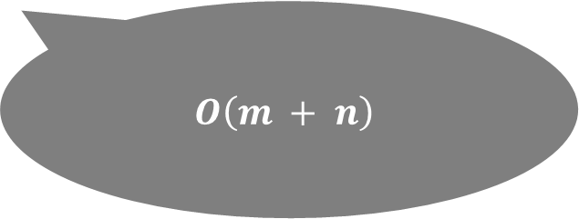
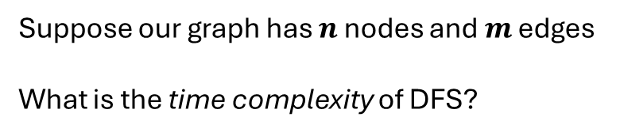
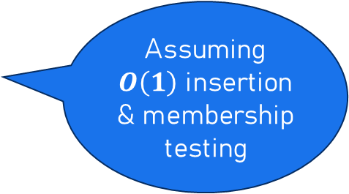
Traversing a Graph – DFS
B
D
function dfs(start):
s ← empty stack
visited ← empty set
s.push(start)
while s not empty:
v = s.pop()
if v not in visited:
visited.insert(v)
for w in neighbors of v:
if w not in visited:
s.push(w)
Assuming $O\left(1\right)$ insertion & membership testing
A
F
C
E
Suppose our graph has $n$ nodes and $m$ edges
What is the time complexity of DFS?
$$O\left(m + n\right)$$

Slide 25
Breadth-first traversal
B
E
G
If a path between two nodes exists, DFS will find it
  But it may not be the shortest path
If we use a queue instead of a stack, we will find the path that has the fewest edges
This is called breadth-first traversal / search (BFS)
C
A
H
D
F
J

Slide 26
Breadth-first traversal
B
E
G
BFS
= Visited
function bfs(start):
s ← empty queue
visited ← empty set
s.enqueue(start)
while s not empty:
v = s.dequeue()
if v not in visited:
visited.insert(v)
for w in neighbors of v:
if w not in visited:
s.enqueue(w)
C
A
H
D
F
J
A
C
F
H
B
D
J
G
E
E
Queue

Slide 27
Breadth-first traversal
B
E
G
BFS
= Visited
function bfs(start):
s ← empty queue
visited ← empty set
s.enqueue(start)
while s not empty:
v = s.dequeue()
if v not in visited:
visited.insert(v)
for w in neighbors of v:
if w not in visited:
s.enqueue(w)
C
A
H
D
F
J
C
F
H
B
D
J
G
E
E
Queue

Slide 28
Breadth-first traversal
B
E
G
BFS
= Visited
function bfs(start):
s ← empty queue
visited ← empty set
s.enqueue(start)
while s not empty:
v = s.dequeue()
if v not in visited:
visited.insert(v)
for w in neighbors of v:
if w not in visited:
s.enqueue(w)
C
A
H
D
F
J
F
H
B
D
J
G
E
E
Queue

Slide 29
Breadth-first traversal
B
E
G
BFS
= Visited
function bfs(start):
s ← empty queue
visited ← empty set
s.enqueue(start)
while s not empty:
v = s.dequeue()
if v not in visited:
visited.insert(v)
for w in neighbors of v:
if w not in visited:
s.enqueue(w)
C
A
H
D
F
J
H
B
D
J
G
E
E
Queue

Slide 30
Breadth-first traversal
B
E
G
BFS
= Visited
function bfs(start):
s ← empty queue
visited ← empty set
s.enqueue(start)
while s not empty:
v = s.dequeue()
if v not in visited:
visited.insert(v)
for w in neighbors of v:
if w not in visited:
s.enqueue(w)
C
A
H
D
F
J
B
D
J
G
E
E
Queue

Slide 31
Breadth-first traversal
B
E
G
BFS
= Visited
function bfs(start):
s ← empty queue
visited ← empty set
s.enqueue(start)
while s not empty:
v = s.dequeue()
if v not in visited:
visited.insert(v)
for w in neighbors of v:
if w not in visited:
s.enqueue(w)
C
A
H
D
F
J
D
J
G
E
E
Queue

Slide 32
Breadth-first traversal
B
E
G
BFS
= Visited
function bfs(start):
s ← empty queue
visited ← empty set
s.enqueue(start)
while s not empty:
v = s.dequeue()
if v not in visited:
visited.insert(v)
for w in neighbors of v:
if w not in visited:
s.enqueue(w)
C
A
H
D
F
J
J
G
E
E
Queue

Slide 33
Breadth-first traversal
B
E
G
BFS
= Visited
function bfs(start):
s ← empty queue
visited ← empty set
s.enqueue(start)
while s not empty:
v = s.dequeue()
if v not in visited:
visited.insert(v)
for w in neighbors of v:
if w not in visited:
s.enqueue(w)
C
A
H
D
F
J
G
E
E
Queue

Slide 34
Breadth-first traversal
B
E
G
BFS
= Visited
function bfs(start):
s ← empty queue
visited ← empty set
s.enqueue(start)
while s not empty:
v = s.dequeue()
if v not in visited:
visited.insert(v)
for w in neighbors of v:
if w not in visited:
s.enqueue(w)
C
A
H
D
F
J
E
E
Queue

Slide 35
Breadth-first traversal
B
E
G
BFS
= Visited
function bfs(start):
s ← empty queue
visited ← empty set
s.enqueue(start)
while s not empty:
v = s.dequeue()
if v not in visited:
visited.insert(v)
for w in neighbors of v:
if w not in visited:
s.enqueue(w)
C
A
H
D
F
J
E
Queue

Slide 36
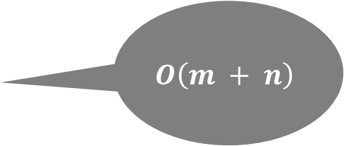
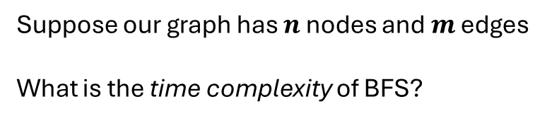
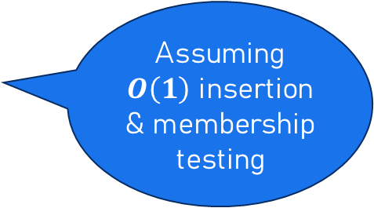
Breadth-first traversal
B
E
G
BFS
= Visited
function bfs(start):
s ← empty queue
visited ← empty set
s.enqueue(start)
while s not empty:
v = s.dequeue()
if v not in visited:
visited.insert(v)
for w in neighbors of v:
if w not in visited:
s.enqueue(w)
Assuming $O\left(1\right)$ insertion & membership testing
C
A
H
D
F
J
Suppose our graph has $n$ nodes and $m$ edges
What is the time complexity of BFS?
$$O\left(m + n\right)$$

Slide 37
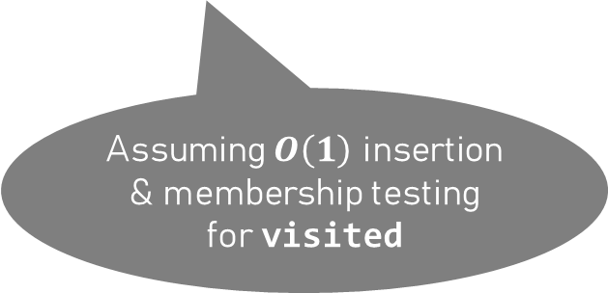
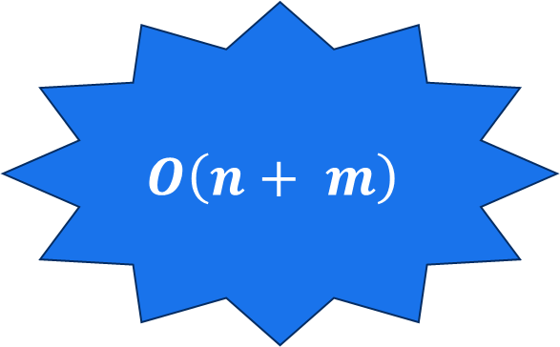
BFS vs DFS
function bfs(start):
s ← empty queue
visited ← empty set
s.enqueue(start)
while s not empty:
v = s.dequeue()
if v not in visited:
visited.insert(v)
for w in neighbors of v:
if w not in visited:
s.enqueue(w)
function dfs(start):
s ← empty stack
visited ← empty set
s.push(start)
while s not empty:
v = s.pop()
if v not in visited:
visited.insert(v)
for w in neighbors of v:
if w not in visited:
s.push(w)
$$O\left(n+ m\right)$$
Assuming $O\left(1\right)$ insertion & membership testing for visited

Slide 38
Directed graphs & dependencies
Directed graphs can be used to represent dependencies
  Example: course prerequisites, project planning, source / include files
Algorithms &
Data Structures
Requires
C++
Requires
Programming 2
Testing
Requires
Implementation
Requires
Design
Executable
Requires
Source files
Requires
Header files

Slide 39

Directed graphs & dependencies
Directed graphs can be used to represent dependencies
  Example: course prerequisites, project planning, source / include files
Algorithms &
Data Structures
Requires
C++
Requires
Programming 2
Testing
Requires
Implementation
Requires
Design
Executable
Requires
Source files
Requires
Header files

Slide 40
Directed graphs & dependencies
Directed graphs can be used to represent dependencies
  Example: course prerequisites, project planning, source / include files
Algorithms &
Data Structures
C++
Programming 2
Testing
Implementation
Design
Executable
Source files
Header files

Slide 41
Directed graphs & dependencies
Directed graphs can be used to represent dependencies
  Example: course prerequisites, project planning, source / include files
Algorithms &
Data Structures
C++
Programming 2
Testing
Implementation
Design
Executable
Source files
Header files

Slide 42
Directed graphs & dependencies
Directed graphs can be used to represent dependencies
  Example: course prerequisites, project planning, source / include files
Dependee
Dependency
Testing
Implementation
Successor
Predecessor
Testing depends on implementation
Testing must come after implementation
(implementation precedes testing, testing succeeds implementation)

Slide 43
Directed graphs & dependencies
Problem: given a set of dependencies, how can we find an order in which to resolve them?
Makefile
program
7
program: main.o functions.o liblibrary.so
$(CC) -o program main.o functions.o -L. -llibrary
main.o: main.c
$(CC) -c main.c -o main.o
functions.o: functions.c
$(CC) -c functions.c -o functions.o
liblibrary.so: library.c
$(CC) -shared -fPIC -o liblibrary.so library.c
5
6
main.o
functions.o
3
main.c
2
functions.c
liblibrary.so
4
1
library.c

Slide 44
Directed graphs & dependencies
Problem: given a set of dependencies, how can we find an order in which to resolve them?
Makefile
program: main.c functions.c
$(CC) -o program main.c functions.c
main.c: functions.c
cp functions.c main.c
functions.c: main.c
cp main.c functions.c
program
main.c
functions.c
make: Circular functions.c <- main.c dependency dropped.

Slide 45
Directed graphs & dependencies
Problem: given a set of dependencies, how can we find an order in which to resolve them?
This problem is called topological sorting
Makefile
program: main.c functions.c
$(CC) -o program main.c functions.c
main.c: functions.c
cp functions.c main.c
functions.c: main.c
cp main.c functions.c

Slide 46
Pre and post order traversal
When dealing with dependencies, acting before of after the recursive call makes a huge difference!
Back to trees: which code correctly deallocates a binary tree?
D
void free(Node* root) {
if (!root) return;
free(root->left);
free(root->right);
delete root;
}
void free(Node* root) {
if (!root) return;
delete root;
free(root->left);
free(root->right);
}
B
F
A
C
E
G
delete post recursive call
delete pre recursive call
deletion order: ACBEGFD
deletion order: DBACFEG

Slide 47

Dependencies, pre and post order
Pre-order traversal: visit node before its successors
function dfs(v, visited):
visited.insert(v)
print(v)
colour_node(v, 'blue')
for w in neighbors(v):
if w not in visited:
dfs(w, visited)
colour_node(v, 'red')
B
D
Pre visit
A
F
C
E
May visit predecessor after successor (e.g. E after F)
Post visit
Output:
A
B
D
F
E
C
Or:
A
C
D
E
F
B

Slide 48

Dependencies, pre and post order
Post-order traversal: first visit successors, then visit node
function dfs(v, visited):
visited.insert(v)
colour_node(v, 'blue')
for w in neighbors(v):
if w not in visited:
dfs(w, visited)
colour_node(v, 'red')
print(v)
B
D
Pre visit
A
F
C
E
Can’t visit predecessor before successor!
How
About
Reversing?
Post visit
Output:
F
E
D
B
C
A
Or:
F
E
D
C
B
A

Slide 49
Dependencies, pre and post order
Reversed post order: visit successors after predecessors
  This is called a “topological order”
Topological order is useful, for example:
  Order in which tasks must be scheduled
  Order in which memory must be deallocated
  Order in which libraries must be compiled
B
D
A
F
C
E
Reversed post:
A
C
B
D
E
F
Or:
A
B
C
D
E
F

Slide 50
Dependencies, pre and post order
Let’s start a DFS from node D
Topological sorting: run DFS from any node & record post order
  Repeat until all nodes are visited
B
D
A
F
C
E
Pre order:
D
E
F
Post order:
F
E
D

Slide 51
Dependencies, pre and post order
Let’s now do a DFS from node B
Topological sorting: run DFS from any node & record post order
  Repeat until all nodes are visited
B
D
A
F
C
E
Pre order:
D
E
F
B
Post order:
F
E
D
B

Slide 52
Dependencies, pre and post order
And finally, let’s do a DFS from node A
Topological sorting: run DFS from any node & record post order
  Repeat until all nodes are visited
B
D
A
F
C
E
Pre order:
D
E
F
B
A
C
Post order:
F
E
D
B
C
A

Slide 53
Dependencies, pre and post order
Topological sorting: run DFS from any node & record post order
  Repeat until all nodes are visited
B
D
A
F
C
E
Topological order:
A
C
B
D
E
F
Pre order:
D
E
F
B
A
C
Time complexity: $O\left(n + m\right)$ (n = #nodes, m = #edges)
Post order:
F
E
D
B
C
A

Slide 54
DFS – Dealing with cycles
What if there’s a cycle?
  No “topological ordering exists” - we should detect it!
Cycle: we can reach a node that lies on the current path
  It was pre-visited but not yet post-visited
Keep track of how many times we’ve visited it
  Pre visit: first time, post visit: second time
B
D
A
F
C
E

Slide 55
Using DFS to find cycles
B
D
Finding cycles using DFS
A
F
function dfs(start, visited):
visited[start] = 1
colour_node(start, 'blue')
for neighbor in neighbors(start):
if visited[neighbor] == 0:
dfs(neighbor, visited)
else if visited[neighbor] == 1:
report_cycle()
colour_node(start, 'red')
visited[start] = 2
C
E

Slide 56
Summary – graphs & terminology
Graphs are made of Nodes (or Vertices) and Edges
  Sequences of connected edges form paths & (possibly) cycles
  Basic “operations” are insertion/removal of nodes/edges, and lookup
  Instead of focusing on these operations, we focus on the algorithms that are run on graphs
Different types of graphs:
  Directed versus undirected
  (Strongly) connected versus weakly / disconnected
  Edges can have weights (more on this in week 7)

Slide 57
Summary – graph algorithms
Traversal (for example, finding paths & reachable nodes)
  Depth-first: uses a stack to enqueue neighbours
  Breadth-first: uses a queue to enqueue neighbours
Topological sorting in the context of “dependencies”: must use depth-first
  Pre-order and post-order traversal
Finding cycles by checking if we can reach a node that lies on the current path
  Current path = pre-visited but not yet post-visited

